Slide 1


Bharati Vidyapeeth
(Deemed to be University)
College of Engineering, Pune
DEPARTMENT OF INFORMATION TECHNOLOGY
TOPIC : “Traffic Control Monitoring System”
Under the guidance of
Prof. Prakash Devale
ROLL NO. | NAME | PRN
01 | Harsh Kumar Agarwal | 2214110233
06 | Aryan Kumar | 2214110238
22 | R. Gokul | 2214110255
27 | Kumar Sarthak | 2214110260

Slide 2
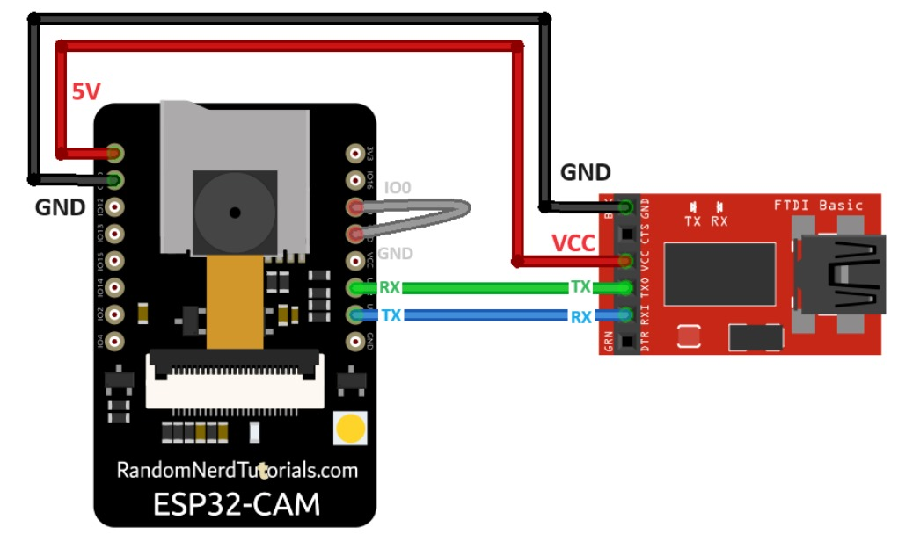
ESPCAM-32:
The ESP32-CAM (often referred to as ESPCAM-32) is a small, cost-effective development board that combines the power of the ESP32 microcontroller with a built-in camera. It’s widely used in IoT, security, and video streaming projects due to its capabilities and compact size. Key details about the ESP32-CAM are:
1. Microcontroller: ESP32-S module: A dual-core microcontroller with Wi-Fi and Bluetooth (BLE) capabilities.
2. Camera: o Comes with an OV2640 camera module (2MP, with resolutions up to 1600x1200).
3. Storage: Supports MicroSD cards for data logging or local storage of images and video.
4. Connectivity: Built-in Wi-Fi for wireless data transmission or remote access.
o Bluetooth is available for additional communication needs.
5. GPIO Pins
6. Power: Can be powered via a 5V supply (USB or external).
7. Programming: Supports programming via the Arduino IDE or ESP-IDF (Espressif IoT Development Framework).

Slide 3
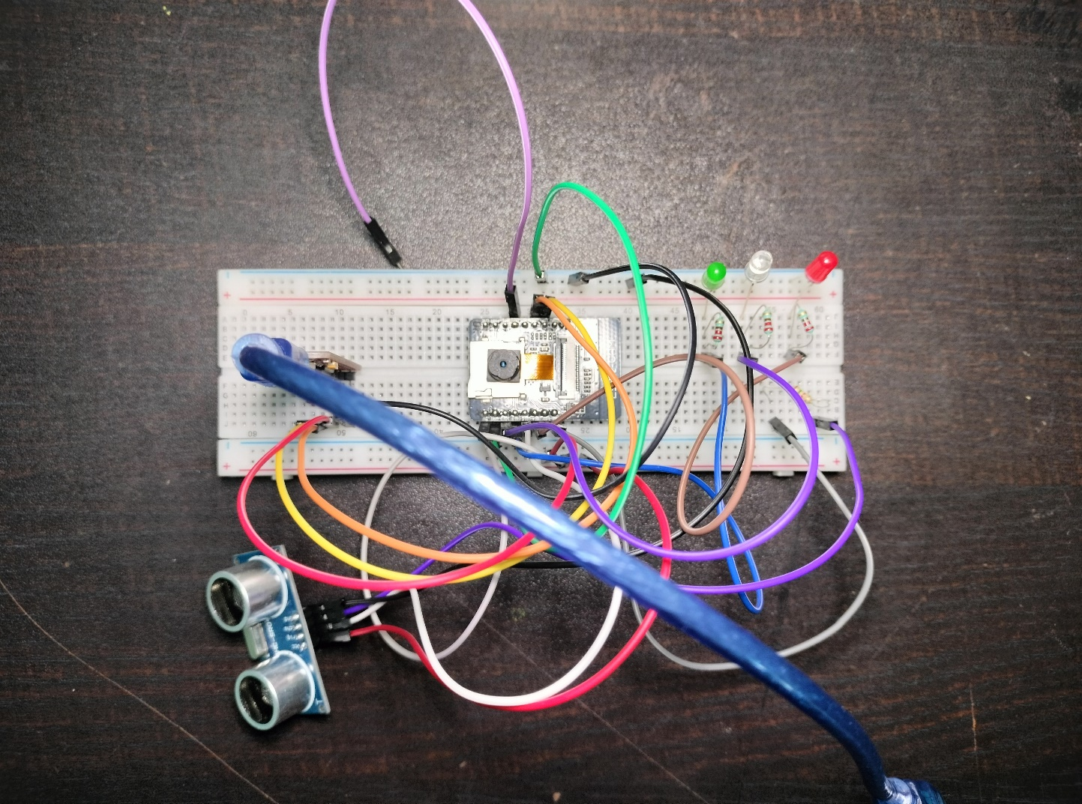
Key Components:
ESP32-CAM Module
FTDI programmer
Ultrasonic Sensor (HC-SR04)
LEDs
220 ohm Resistors
Jumper Wires
Breadboard

Slide 4
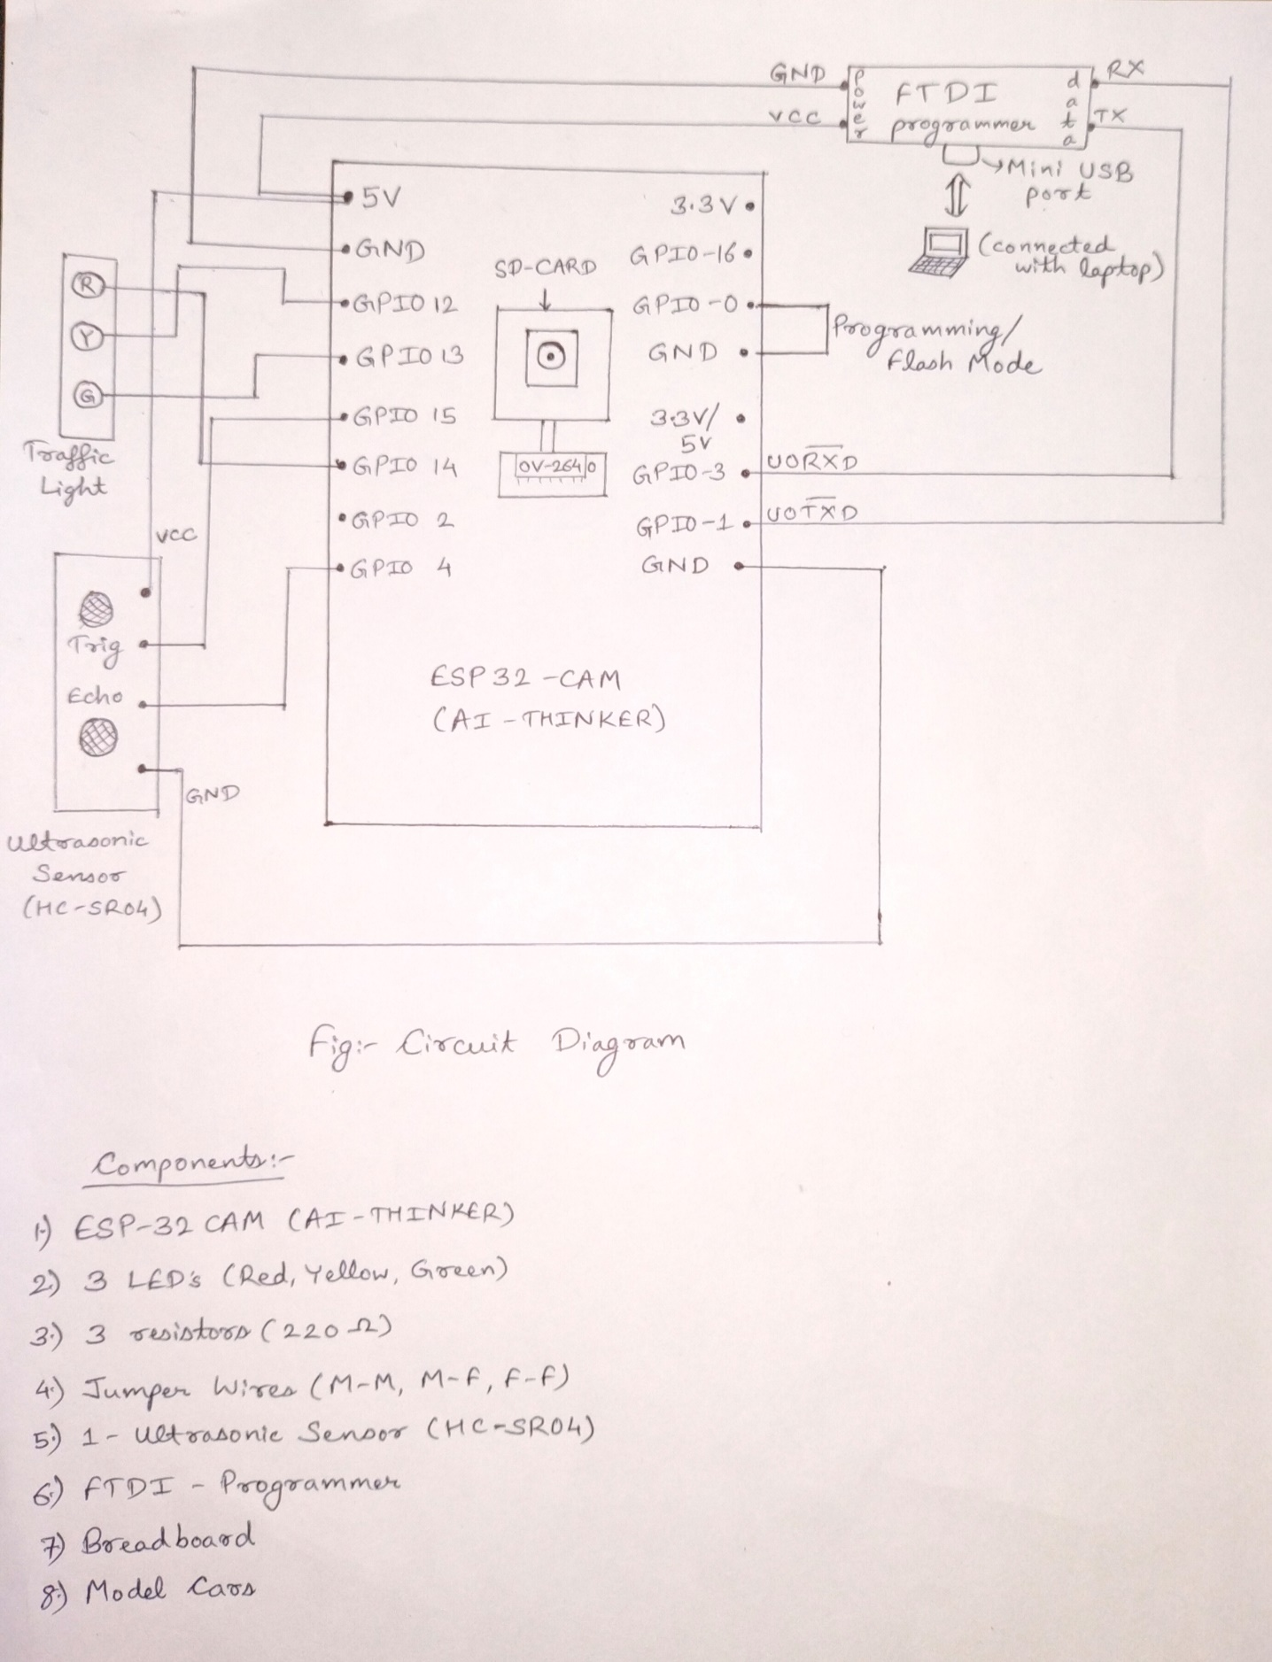
Circuit Diagram:
1. ESP32-CAM Setup
● FTDI Programmer: This will be used to upload code to the ESP32-CAM. Ensure that the FTDI programmer is set to 5V.
● Connections for Programming:
● Connect the GND pin on the FTDI programmer to GND on the ESP32-CAM.
● Connect the VCC (5V) pin on the FTDI to the 5V pin on the ESP32-CAM.
● Connect the TX pin on the FTDI to the U0R (RX) pin on the ESP32-CAM.
● Connect the RX pin on the FTDI to the U0T (TX) pin on the ESP32-CAM.
● To put the ESP32-CAM into programming mode, connect the IO0 pin to GND before uploading code. Once the code is uploaded, disconnect IO0 from GND.
2. Connecting the Traffic Lights (LEDs)
● Red Light (LED): Connect the anode (longer leg) of the red LED to GPIO 14 on the ESP32-CAM via a 220Ω resistor, and the cathode (shorter leg) to GND.
● Yellow Light (LED): Connect the anode of the yellow LED to GPIO 12 via a 220Ω resistor, and the cathode to GND.
● Green Light (LED): Connect the anode of the green LED to GPIO 13 via a 220Ω resistor, and the cathode to GND.
3. Connecting the Ultrasonic Sensor HC-SR04 for Vehicle Detection
● Power: Connect the VCC pin of the ultrasonic sensor to the 5V pin on the ESP32-CAM, and GND to the common ground.
● Trigger Pin: Connect the Trig pin of the HC-SR04 to GPIO 15 on the ESP32-CAM.
● Echo Pin: Connect the Echo pin of the HC-SR04 to GPIO 4 on the ESP32-CAM.
● Note: Since the Echo pin outputs 5V, use a voltage divider (e.g., 1kΩ and 2kΩ resistors) to drop it to a safe 3.3V for the ESP32-CAM's GPIO.

Slide 5
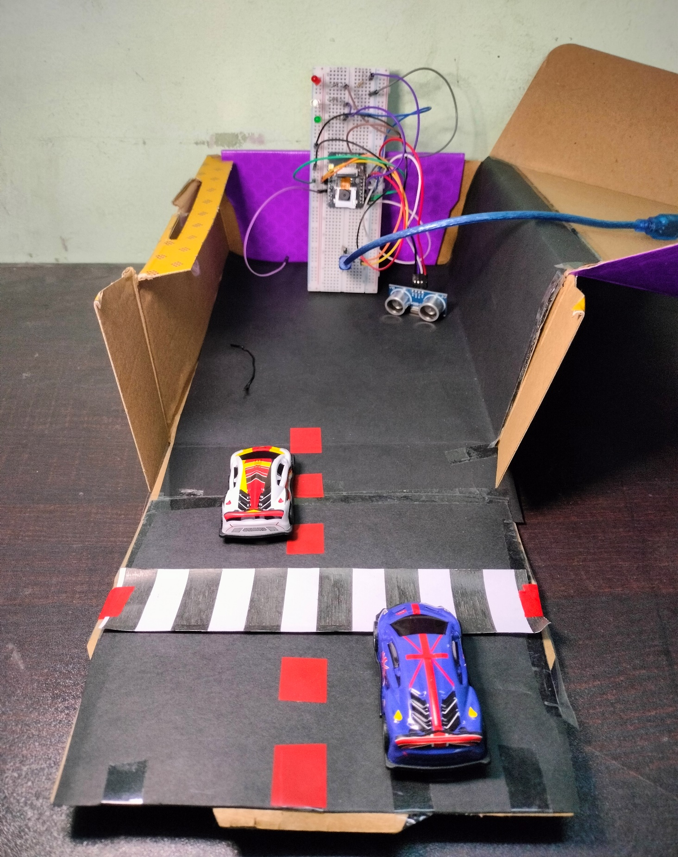
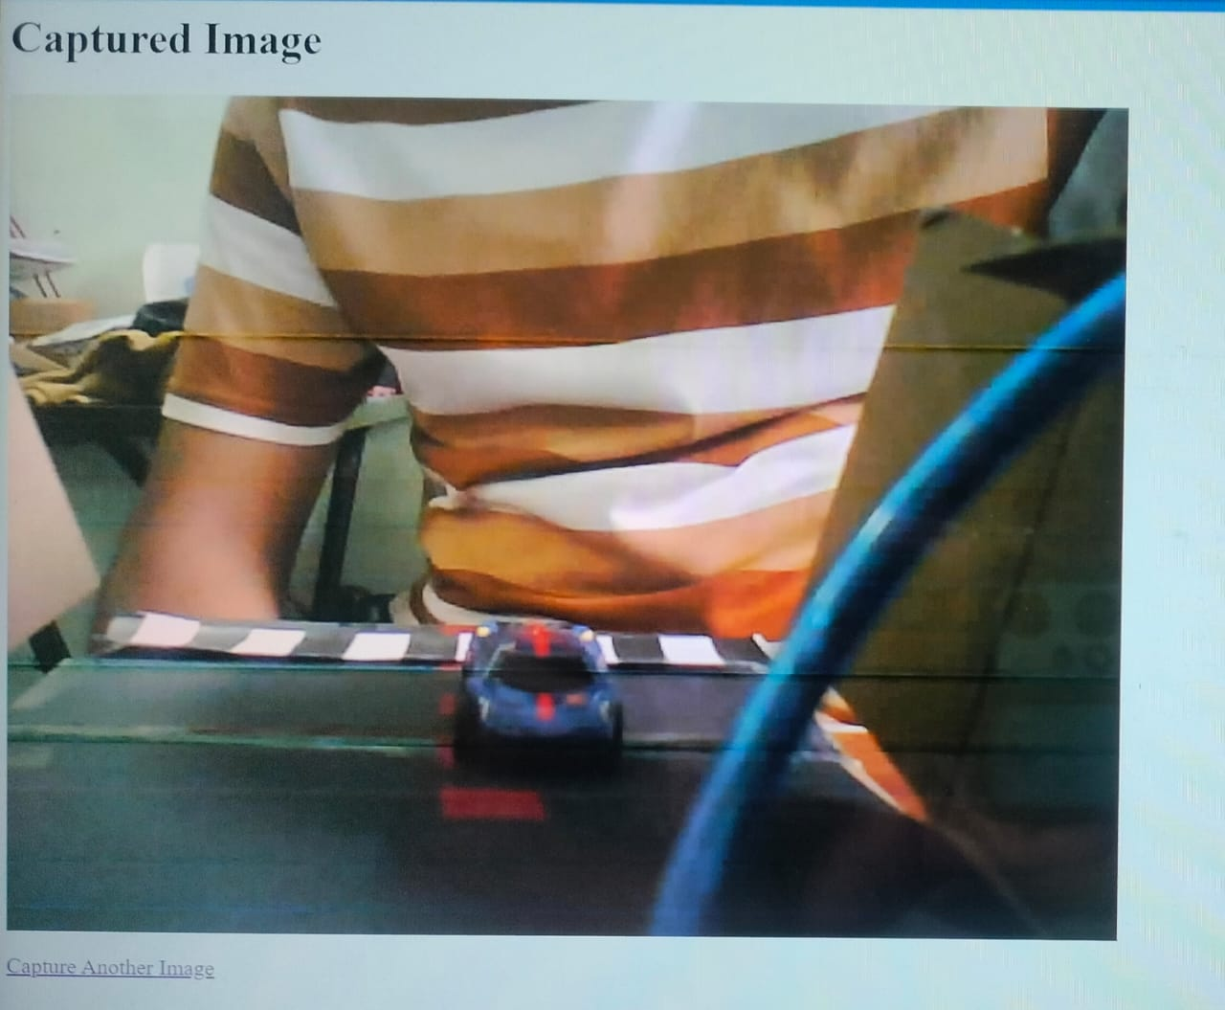
Model: Output:

Slide 6
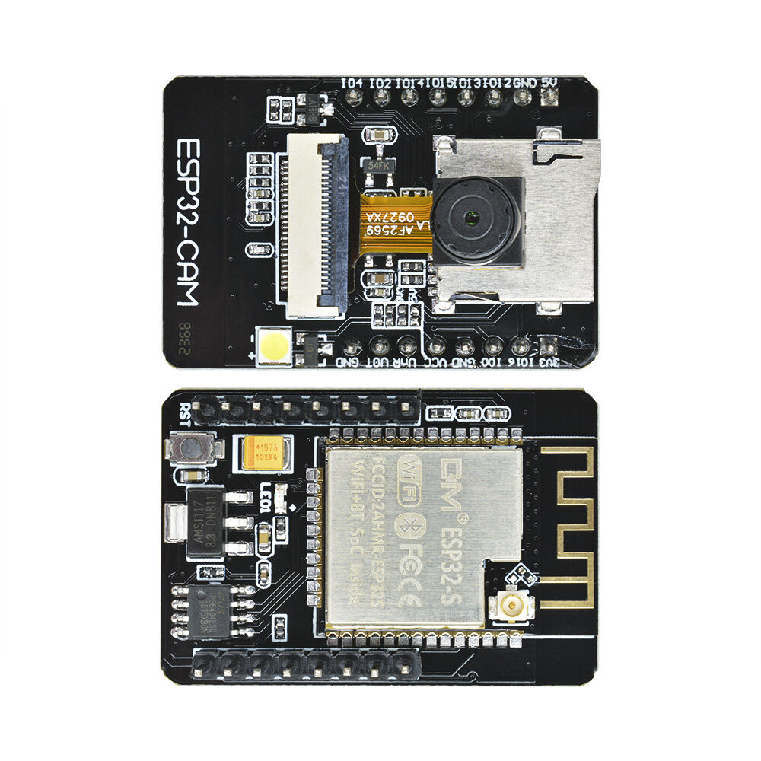
Applications:
Public Transportation Monitoring
Traffic Violation Detection
Event Traffic Management
Pedestrian Safety Monitoring
Vehicle Classification
Traffic Simulation and Modeling
Automated Traffic Reports

Slide 7
Thank You!

